Slide 1
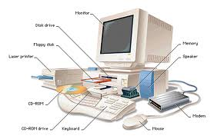
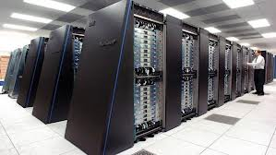
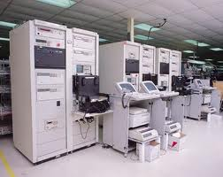
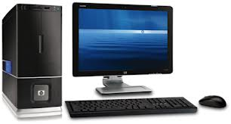
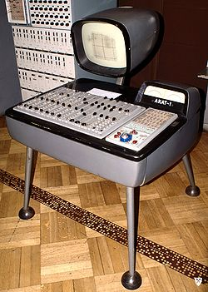
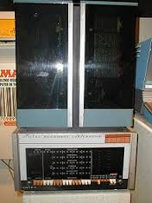
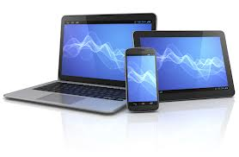
INTRODUCTION TO COMPUTERS

Slide 2
1617 Napiers Bones : John Napier
1642 Calculator : Blaise Pascal
1801 Card of holes for weaving pattern : Joseph Jacquard.
1823-24 Analytical Engine(1st Computer) : Charles Babbage.

Slide 3
Objectives
At the end of this course, students will be able to do the following:
Definition of Computer ·
Types of computers .
Input & output devices ·
Memory and processing Device ·
Storage Devices ·
Introduction to Operating System

Slide 4
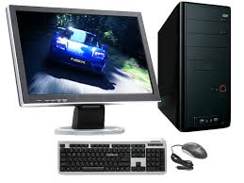
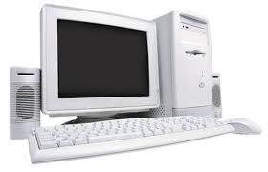
Introduction to computer
A computer is an electronic device, which will operate on arithmetic and Logical operations.

Slide 5
A primitive computer
A basic computer (primitive) consists of three major components:
CPU (Central Processing Unit)
IO (Input/Output)
Memory
CPU
Input
Output
Memory
Data comes through input and the CPU process it based on a program in memory. And the (result) output returned to memory or presented to the user.

Slide 6
MEMORY
BIT = One Binary Digit 0 or 1
BYTE = 08 Bits
(NIBBLE= 4 Bits)
KILOBYTE=1024BYTES
MEGABYTE=1024KB
GIGABYTE=1024MB
TERABYTE=1024GB
PETABYTE=1024TB

Slide 7
COMPUTER GENERATIONS
FIRST GENERATION : 1949-54
SECOND GENERATION :1954-64
THIRD GENERATION :1964-80
FOURTH GENERATION :1980-2000
FIFTH GENARATION:2000 ONWARDS

Slide 8
Types of computers
Computer types can be divided into 3 categories according to electronic nature.
Types of computers are classified according to how a particular Computer functions. These computer types are:
· Analogue Computers
· Digital Computers
· Hybrid Computers

Slide 9
Analogue computer (analog)
Analogue computer uses analogue signals that are represented by a continuous set of varying voltages in scientific research centers ,hospitals and flight centers.
Analogue computer types program arithmetic and logical operations by measuring physical changes i.e. temperatures or pressure.

Slide 10
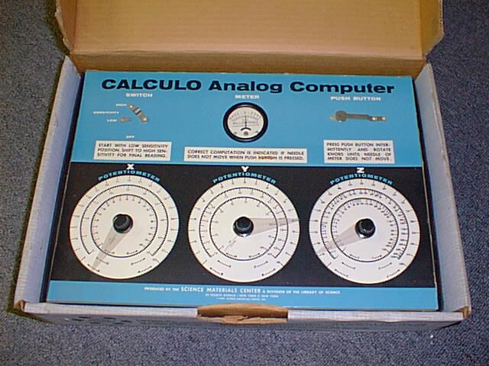
Image of analogue computers

Slide 11
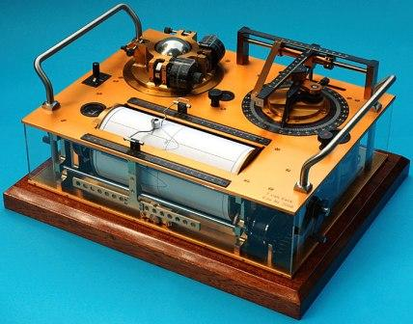
Image of analogue computers

Slide 12
Image of analogue computers

Slide 13
Digital computer
With these types of computers operation are on electrical input that can attain two inputs, states of ON=1 and state of OFF = 0.
With digital type of computers data is represented by digital of 0 and 1 or off state and on state.
Digital computer type recognizes data by counting discrete signal of (0 0r 1), they are high speed programmable; they compute values and stores results.

Slide 14
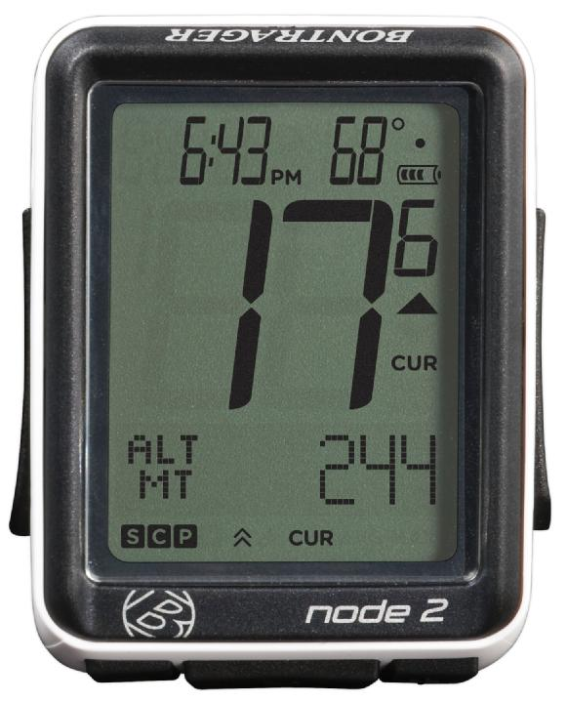
Image of a digital computer

Slide 15
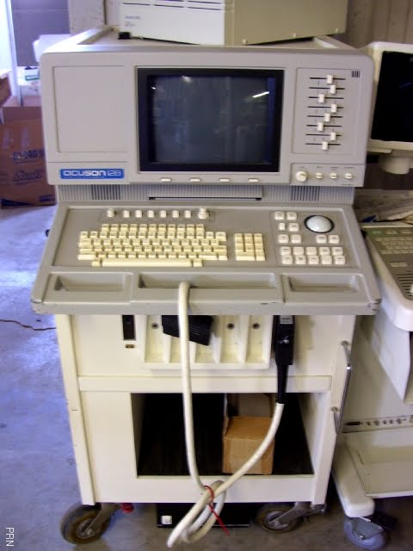
Image of a digital computer

Slide 16
hybrid computer
Hybrid computer types are very unique, in the sense that they combined both analogue and digital features and operations.
Hybrid computers operate by using digital to analogue convertor and analogue to digital convertor.
E.g. personal computer

Slide 17
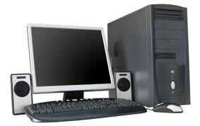
hybrid computer hybrid computer
images of hybrid computer

Slide 18
Classification of Computers
The classification of computers according to size / appearance relates to the grouping of computers according to their physical structure.
The computer classification from the largest to the smallest single unit is as follows:
Supercomputers, Mainframe Computers, Mini Computers, and Micro Computers

Slide 19
Supercomputers:
Super computer are the fastest high capacity computers and very expensive.
Used for calculating speed and volumes in weather forecasting, oil exploitation, aircraft designing and handle about 1000 user at a time.

Slide 20
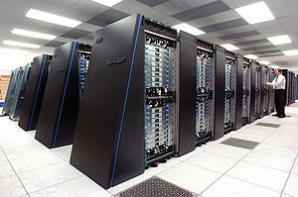
An example of a supper computer

Slide 21
Mainframe computers
Mainframe computers are powerful computers used mainly by large organizations for critical applications.
Typically bulk data processing such as census, industry and consumer statistics, enterprise resource planning, and financial transaction processing.

Slide 22
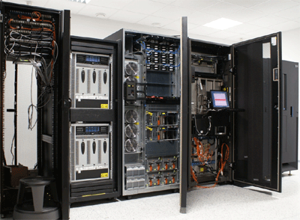
An example of a mainframe computer

Slide 23
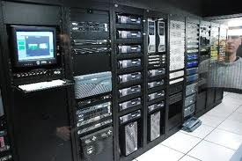
An example of a mainframe computer

Slide 24
MINI COMPUTER
. Minicomputer are mid-range called refrigerator machine with less storage capacity and processing speed.
Used by small companies for accounting and finance, and handle about 4 to 100 users at a time.

Slide 25
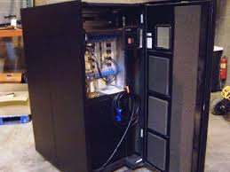
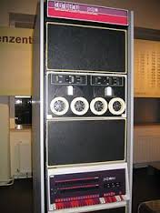
An example of a mini computer

Slide 26
MICRO COMPUTER
Personal Computer is the smallest with low storage capacity and processing speed.
It support only one monitor, key board and a user at a time.

Slide 27
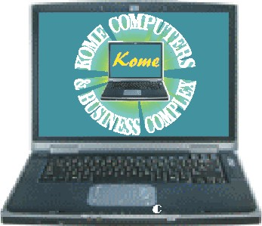
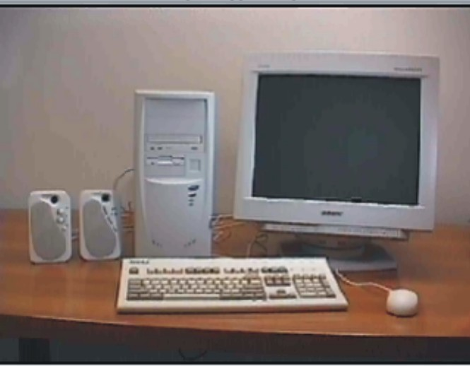
EXAMPLE OF MICRO COMPUTERS

Slide 28
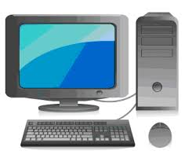
Basic parts of a computer
There are four (4) basic parts of a computer:
Mouse
Keyboard
Monitor
System Unit

Slide 29
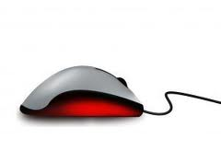
Mouse
A mouse is a hand-held or an input device that controls the movement of pointer on the screen.
Position the pointer on an object is known as pointing.
Mouse

Slide 30
Types of Mouse
There are many types of computer mice, but the three (3)common types are namely:
Base on their ports
PS/2 mouse
USB mouse
Serial mouse

Slide 31
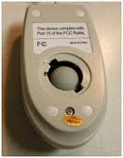
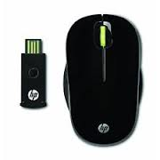
Types of Mouse
There are many types of computer mice, but the three (3)common types are namely:
Base on their designed
standard mouse
optical mouse
wireless mouse

Slide 32
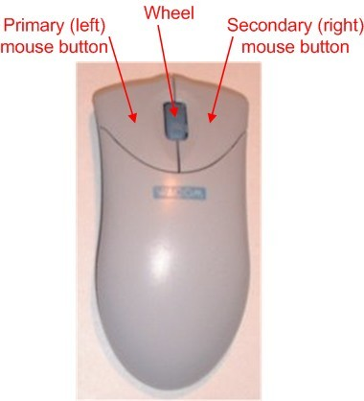
Parts of a mouse
Plastic case (body)

Slide 33
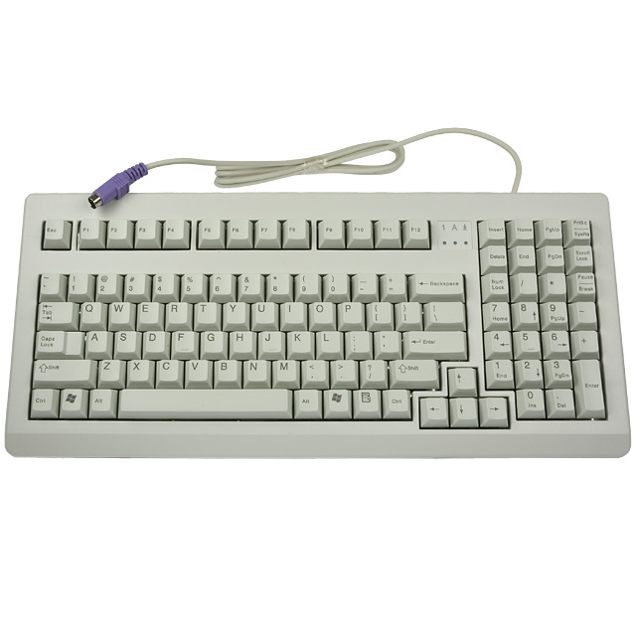
keyboard
The keyboard is the primary input device for entering data and executing commands.
The keyboard is laid out like the keys on a typewriter.
It has 102 to 110 keys and with 256 to 260 characters.

Slide 34
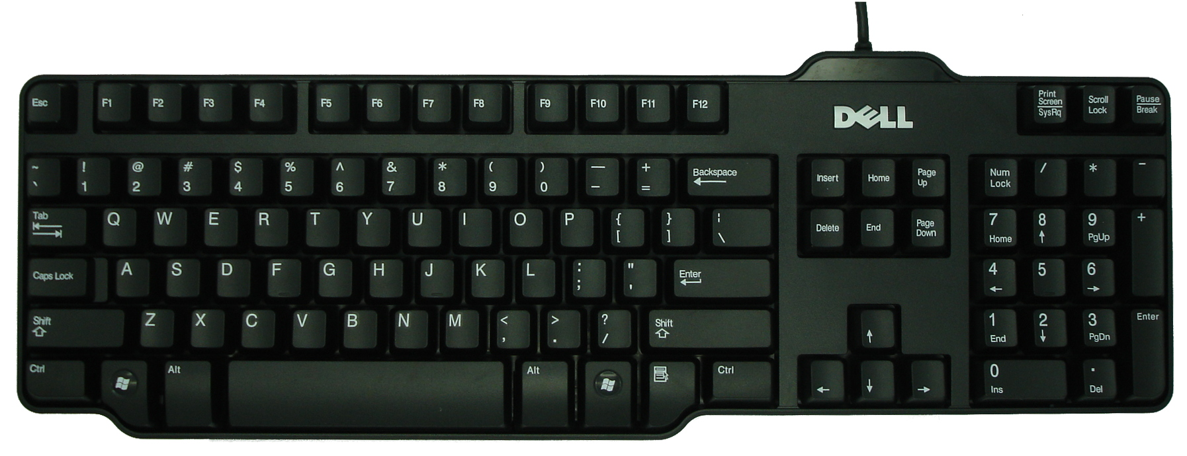
Parts of a keyboard
The computer keyboard is divided into five main parts as showed below
Home Keys
Function Keys
Calculator Keys
Arrow Keys
Typing Standard Key
BY ABDUL-RAHAMAN

Slide 35
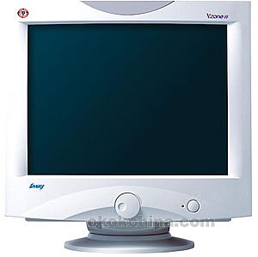
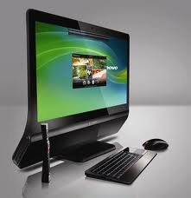
Monitor
Is a display unit used to view the content of the system unit. The screen is made up of red, green and blue dots.
The video card send signals out to the monitor. The information video card sends control which dots are light up and how bright they are determines the picture you see.
Another name for a monitor is video display terminal (VDT) or Visual display unit (VDU).

Slide 36
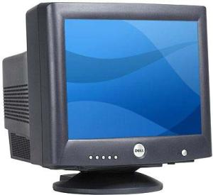
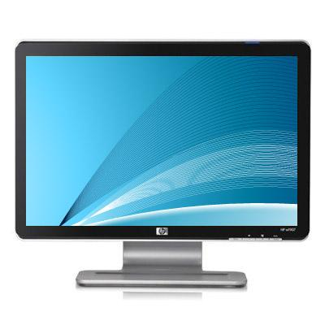
Types of monitor
There are two (2) types of monitor as follows:
Cathode Ray Tube (CRT)
Liquid crystal Display (LCD)

Slide 37
LIQUID CRYSTAL DISPLAY (LCD)
The LCD (Liquid Crystal Display).
This is also called Flat screen.
It has the following advantages over the CRT:
Takes up less space
Lighter in weight
Uses less power

Slide 38
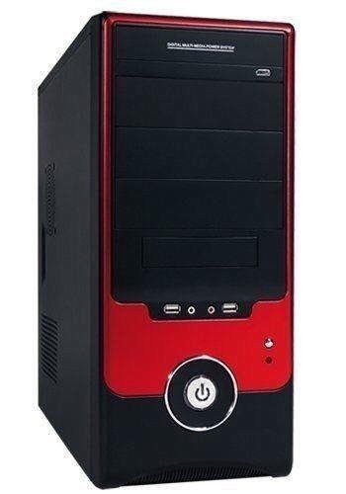
System unit
It is also known as a base unit, is the main body of a desktop computer.
It consisting of a plastic case containing the motherboard, power supply, cooling fans, memory models and expansion cards that are plugged into the motherboard, such as video and network card.
System Unit
Notes:
BY ABDUL-RAHAMAN

Slide 39
TYPES OF SYSTEM UNIT
They are two (2) types of system unit

Slide 40
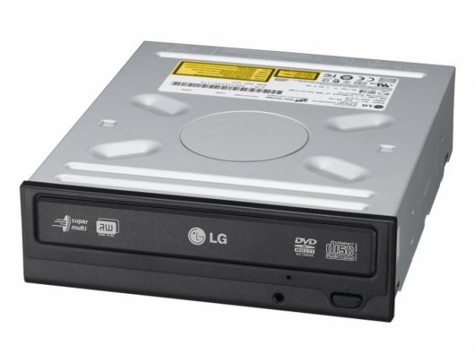
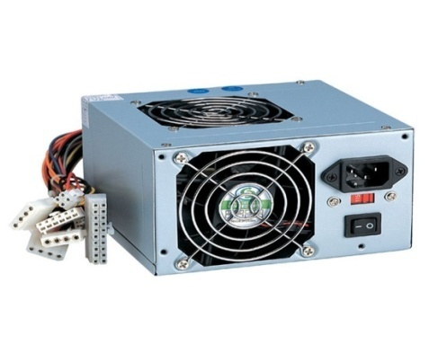
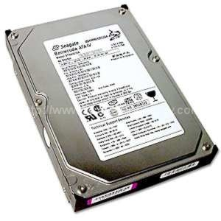
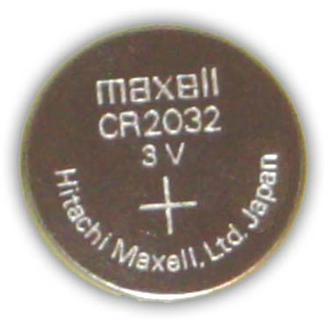
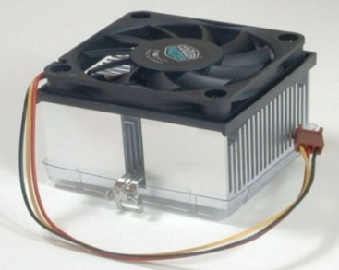
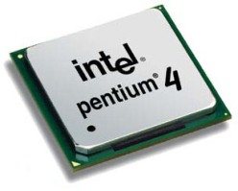
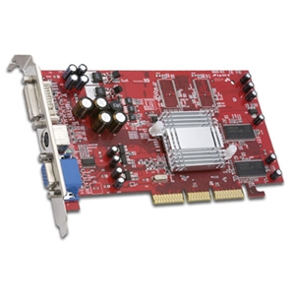
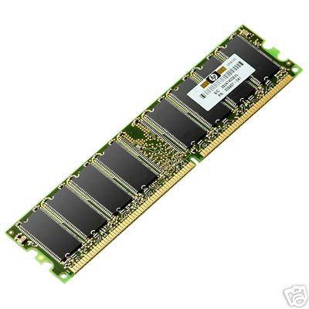
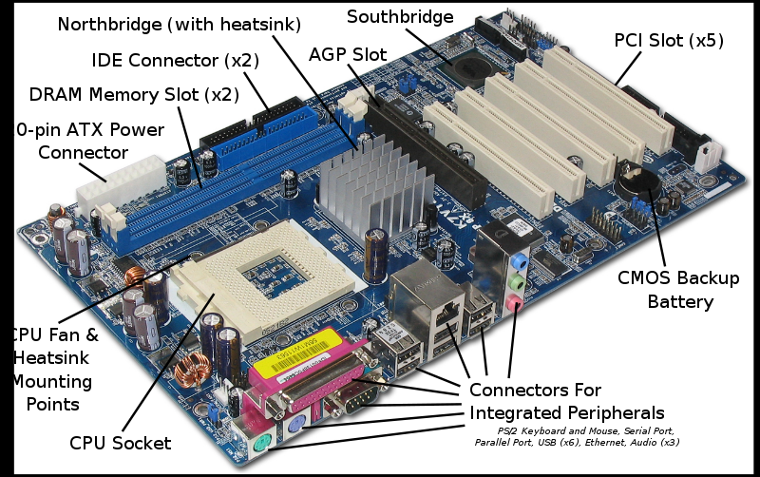
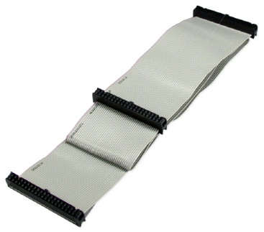
Components of the System unit
Hard Disk
Power Pack
Cmon Battery
CD-ROM Drive
Cooling Fan
Floppy Disk Drive
Heat Sink
CPU
Video Card (VGA)
Mother Board
Memory
Ribbon Cables

Slide 41
Motherboard
The motherboard is the main circuit board in which all component communicate through in the PC.
Every components either directly plugging into it or communicating through the motherboards ports.

Slide 42
Cmos battery
A tiny device on the motherboard that create a computer system to run smoothly.
Its function is to keep the computer date and time up till date.

Slide 43
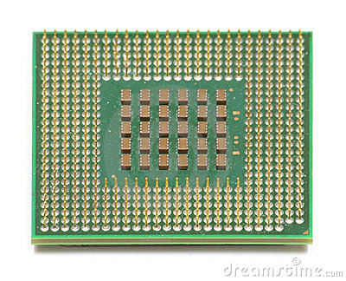
Central processing unit (cpu)
A CPU is the brain that runs a computer. CPU (Central Processing Unit) is the core chip to a computer.
It process data to information which is then outputted to the user.
Another name for a CPU is Processor

Slide 44
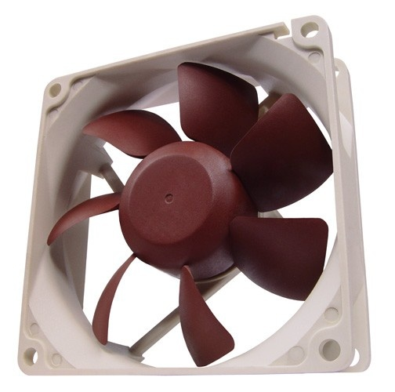
Cooling fan
The cooling fan produce air to cool the heat sink so it can absorb more heat from the processor (CPU)
The CPU - produce a ton of heat and cause overheating to the machine if not check will crash the computer.

Slide 45
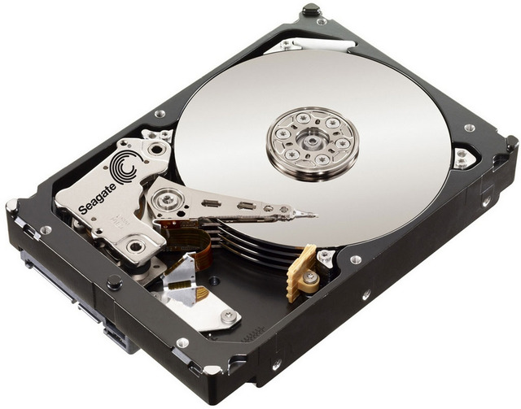
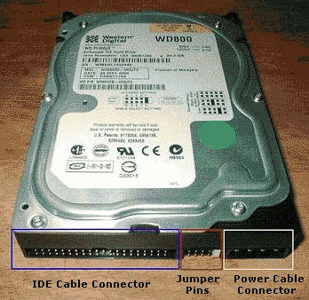
Hard disk drive (HDD)
The hard disk drive is the main primarily storage device for the computer system that stores all data and files.
Also known as the "C drive" because Microsoft assigns the "C" drive letter to the primary partition(division) by default on the primary hard drive.

Slide 46
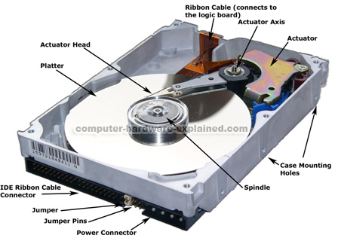
Parts of a Hard Disk Drive

Slide 47
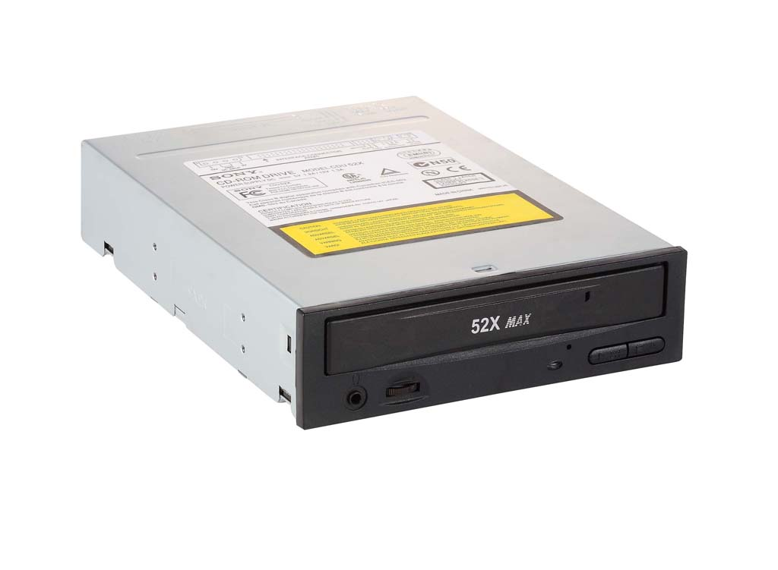
Cd-rom drive
A CD drive is connected to a computer and on which a CD-ROM can be ‘played’ (computer science) a device that writes data onto or reads data from a storage medium.
DVD Multi Recorder Drive
CD-ROM Drive

Slide 48
Floppy disk drive(FDD)
It is a small drive that takes a little plastic square shaped disks.
Is a place where a floppy disk(a diskette) is inserted (removable storage device).
They are out of date, pen drives can take much data/information than diskette.
Today new computers are sold without a floppy disk drive.
Floppy Disk Drive

Slide 49
Floppy diskette
It is a magnetic disc with a microfilm and capable of storing information depending on the density.
They are read and written by a floppy disk drive (FDD).
It is slotted into the floppy disk drive (Drive A: B: ) computer to access the information stored on it.

Slide 50
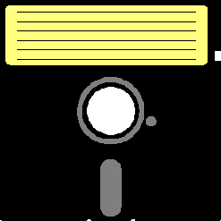
Type of Floppy diskette
There are two (2) types of floppy diskettes as follow:
3½ floppy diskette
5¼ floppy diskette

Slide 51
3½ Floppy diskette
It is a magnetic disc with a microfilm and capable of storing information depending on the density, slotted into the floppy disk drive (Drive A:)
3½ Floppy Diskette
Capable of storing from 400K to 1.4MB of data. The common once are 720K (double-density) and 1.44MB (high-density).
Macintoshes support disks of 400K, 800K, and 1.2MB.

Slide 52
5¼ Floppy diskette
This is also a magnetic disc with a microfilm and capable of storing
information depending on the density, slotted into the diskette drive (Drive B:)
5¼ Floppy Diskette
It is capable of storing between 100K and 1.2MB (megabytes) of data.
The most common sizes are 360K and 1.2MB.

Slide 53
memory
The computer memory is a temporary storage device which holds the data and instructions that (CPU) needs to process.
Before a program can be run, it must be loaded from a storage medium (hard disk) into the memory for CPU to have direct access to it.
Memory is a necessity to every computer. It is primary storage device, it can be either ROM or RAM

Slide 54
Types of memory
There are two (2) main types of computer memory as follow:
Read Only Memory (ROM)
Random Access Memory (RAM)

Slide 55
READ ONLY MEMORY (ROM)
The Read-Only Memory (ROM) stores the BIOS that runs when the computer is powered on.
Or otherwise begins execution, a process known as Bootstrapping, or "booting" or "booting up".

Slide 56
RANDOM ACCESS MEMORY (RAM)
RAM is the working memory of a computer system that stores input data, intermediate results, programs, and other information temporarily.
It can be read and written. It is volatile, that is all data will be erased when the power is turned off.

Slide 57
Power supply (power pack)
A power supply unit (PSU) converts alternating current (AC) electric power to low-voltage direct current (DC) power for the internal components of the computer. Is mostly found in the system unit.
Inside a Power Pack
Power Pack

Slide 58
Video card (VGA)
The video card is responsible for what you see on the monitor.
The main function of the video card is to generate and output images to the computer screen.
Better graphics card equals better performance when playing games or working on a high resolution monitor.

Slide 59
Type of Video cards (VGA)
AGP Video Card
PCI Express Video Card
PCI Video Card

Slide 60
Peripheral devices
Peripheral device are optional device connected to the computer externally such as printer, scanner, tape device, microphone and external modem.
And internal such as CD-ROM or internal modem and CPU, expansion cards.
Peripheral devices are classified base on their functions.
Scanner
Microphone
Speakers
Printer
Plotter
Projector
Light Pen
Wireless Router
Web Cam

Slide 61
Printer
This device is used to print a report or hardcopy, after data or information has been processes.
Printers are designed to print in any colour, but some, just one colour i.e. Black.
A print out from the printer is term as hardcopy.
Canon SELPHY DS810
HP Laser Jet 2055
Prints only black
Prints any colour

Slide 62
scanner
A scanner is a device that is able to transfer images or pictures in to the computer to be store.
Such images or pictures are usually not found in the computer; thus the need to be scan.
HP Scanjet 3670
HP ScanJet 4370

Slide 63
Input device
Input devices are devices used to feed information or provide the control signals to the computer.
Keyboard and the Mouse are the examples of the input devices.
Keyboard
Microphone
Mouse
Light Pen
Web Cam
Scanner

Slide 64
Output devices
Output devices are devices used to display results.
Printer, speaker and the monitor are the examples of the output devices.
Projector
Monitor
Plotter
Printer
Speaker

Slide 65
Plotter
Plotters were the first type of printer that could print with colour and render graphics and full-size engineering drawing.
But plotter are much more expensive than printers.
Plotter

Slide 66
Projector
A Projector is an output device that project and display video, images or computer data on a screen or other flat form.
Projector

Slide 67
Sound Speakers
Sound Speakers enable the computer user (liveware) to hear sound from the computer.
Sound speakers

Slide 68
Input/Output device
Referred to as a IO device, an input/output device is a hardware device that accepts inputted information and also has the capability of outputting that information.
Network Card
Touch Screen
Photocopier
Wireless Card
Sound Card
Wireless Router
Modem

Slide 69
Sound card
Also known as an audio card, is an internal computer expansion card that facilitates the input and output of audio signals to and from a computer
Touch screen
It is display screen that allows commands to be entered by touching the screen.
Touch screens are generally used in the locations such as airports and hotels to display certain type of menu.

Slide 70
Storage devices
A storage device is a device that is used to store the information such as hard disk drive, flash drive, floppy disk and the tape drive.
Secure Digital
Card
Hard Disk
Pen Drive
Floppy Diskette
Compact Disc
Secure Digital
Card
Blu-ray DVD
Digital Versatile Disc
Or
Digital Video Disc
Zip Disk
PC Card

Slide 71
Blu-ray dvd
Blu-ray Disc (official abbreviation BD) is an optical disc storage medium designed to supersede the DVD format.
The plastic disc is 120 mm in diameter and 1.2 mm thick, the same size as DVDs and CDs.
Blu-ray Discs contain 25 GB (23.31 GB) per layer, with dual layer discs (50 GB) being the norm for feature-length video discs.
Triple layer discs (100 GB) and quadruple layers (128 GB) are available for BD-XL Blu-ray re-writer drives
.
Philips Double Layer 50GB

Slide 72
THE ZIP DISK
A zip disk is a computer hardware device that stores data.
A zip disk drive is somewhat like floppy disk drive, only that the size of disks inserted into the devices are different.
Where a normal floppy disk can hold about 1.44 megabytes of data, a zip disk can hold around 100 megabytes of data
Zip Disk

Slide 73
User Interface
User interface is the space where interaction between the user and the computer occurs.
Types of User Interface
There are two types of user interfaces between a computer application and the user. They are:
Graphical User Interface (GUI)
Character User Interface (CUI) or Command Line Interface (CLI)

Slide 74
Graphical User Interface (GUI)
Allows users to interact with the computer, using icons, windows and menus, with the help of a pointing device, such as a mouse.
In GUI more task can run simultaneously and user friendly interface.
Application : Windows (Operating System)

Slide 75
Character User Interface (CUI)
An interface that allows users to interact with the computer, using codes (text), with the help of a keyboard.
In CUI one task run at a time. Anther name for Character user interface is Command Line Interface (CLI)
Application : MS Dos (Operating System)

Slide 76
BOOT
Boot is the process of turning on the computer.
To do this, press the power switch that is used to put the unit on.
Nowadays, it is located in front of the computer. Pushing it would start the computer.
System Unit Power
Monitor Power

Slide 77
Types of booting
There are two types of booting namely:
Cool Booting
Warm Booting
Cool booting is the process of putting the switch of the system unit and the monitor on.
Warm booting is the process of restarting the computer.

Slide 78
process of booting
In computing, booting (also known as booting up) is a process that starts operating systems when the user turns on a computer system.
A boot sequence is the initial set of operations that the computer performs when power is switched on. The boot loader typically loads the main operating system for the computer.
Information about computer
Checking components
Type of Operating system
Welcome screen
Desktop

Slide 79
Desktop
The Desktop is a graphical user interface which serves as a communication link between the computer and the user (live ware)

Slide 80
Parts of the desktop
Wallpaper
Icons
Taskbar
Start button
Notification area

Slide 81
Parts of the desktop
Start button -Provides access to Windows XP programs, documents, and information on the Internet. (Generally located in the bottom left corner of the desktop and the far left of the Task bar.)
Taskbar -Contains buttons that give you quick access to common tools and the programs currently running. (Located across the bottom of the desktop.)
Icons are small pictures used to represent programs.
Notification Area located at the bottom right corner of the taskbar tell the user what ever is happening in the computer.
Taskbar
Pointer -A small object, such as an arrow, that moves on the screen when you move the mouse.

Slide 82
Window
A window is a rectangular area of the screen in which you view program folders, files, or icons.
The window is made up of several components that are the same for all windows in Windows XP and Windows applications and make it easy for you to manage your work.

Slide 83
Parts of a window

Slide 84
Parts of a window
Menu bar -Contains the titles of menus, such as File, Edit, and Help. (Located along the top of the window under the Title bar.)
Control Menu Icon-Drop-down menu on the Title bar with the Minimize, Maximize/Restore, Close, Move and Size functions. (Located on the left side of the Title bar)
Title bar -Contains the window title and basic window control buttons. (Located at the top of the window.)
Control Menu Icon in every window, a little icon in the upper-left corner that can be used to control the window.
Clicking the icon opens the window’s control menu while double clicking the icon is a shortcut for closing the window.

Slide 85
Parts of a window
Minimize button a small minus button at the top right window which is used to reduce the window on to the taskbar as an icon ( )
Maximize button two small ( ) rectangular boxes overlap together which is used to increase the size of your windows to fill the screen
Close button a small ( x )button located at the top right corner of the window used to exit out off the window

Slide 86
Computer wares refers to the physical, internal and living parts that makes a computer to work. There are three(3) types of computer wares. (i) hardware (ii) software (iii) live ware
COMPUTER WARES

Slide 87
Hardware – the physical parts of a computer you can see, torch and feel. e.g. system unit, monitor, keyboard, mouse. etc. Software – the internal programs that tell a computer what to do and how to do it, or runs on hardware. E.g. operating system (windows xp, Linux, ubuntu, zubuntu, window 7. etc.) live ware – human beings ( man ,woman, children) that create and use computers.
Hardware

Slide 88
Software
Software is a collection of computer programs and related data that provide instructions for telling a computer what to do and how to do it.
In other words, software is a general name given to all computer program.

Slide 89
Types of Software
There are two (2) types of computer software namely:
System Software
Application Software

Slide 90
System software also known as operating system(o s) the soul of a computer. This program controls the affairs of the computer and manage the hardware resources. E.g. MS DOS, Windows, Linux, Apple, Macintosh, OS/2 etc. Without this program one can not use the computer. Means the operating system have to be installed before the computer can be use, even before the applications.
System software

Slide 91
Application Software
Application Software is a computer software designed to help the user to perform specific tasks.
Examples include:
Enterprise software,
Accounting software,
Office suites,
Graphics software
And media player. etc.

Slide 92
Types of Application Software
There are three (3) types of application software namely:
End-user software ( can be downloaded from internet freely)
Packaged software (created for selling)
Custom-made software (designed purposely for a particular organization)
Utility software for protecting your pc. E.g. Antivirus.

Slide 93
operating system
An operating system (OS) is a set of programs that manage computer hardware resources and provide common services for application software.
The operating system is the most important type of system
software in a computer system.
A user cannot run an application program on the computer without an operating system, unless the application program is self booting.

Slide 94
Thank You

